Slide 1
British Airways
Web scraping to gain company insights
12-09-2023

Slide 2

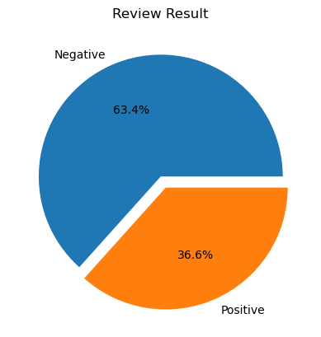
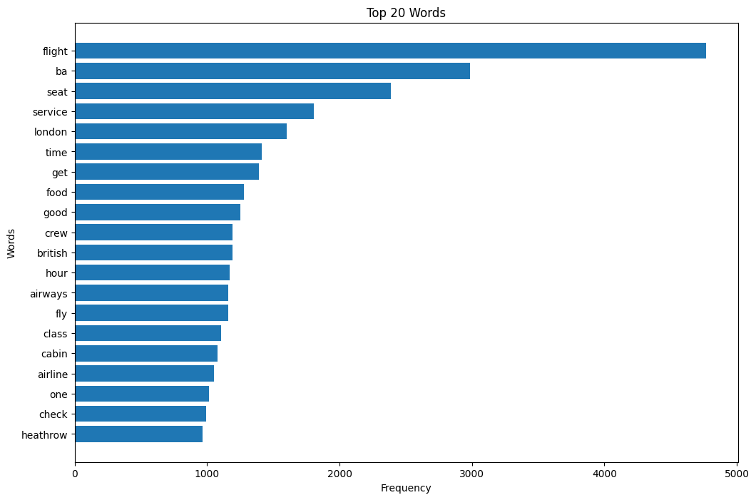
Results
The result from 3000 reviews given by the customers:
Negative: 1901 | Positive: 1099
The frequency of words chart below shows that the key topics within the reviews include “seat”, “service”, “food” and “crew”, shows that our customer likely talks about their experience.

